Slide 1
Ethernet Signaling
GC USB and LAN FG Training
Feb 21, 2017

Slide 2
Overview
Ethernet Background
Connectivity
Repeaters
Switches
Physical Layer
10Base-T
100Base-TX
100Base-FX
1000Base-T
PCB Design Guide
Performance Test

Slide 3
Ethernet Background
How it started, why it started.

Slide 4
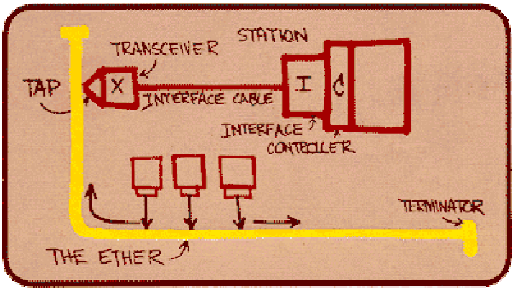
Ethernet Background
1972 – Robert Metcalfe networked Xerox Alto products together via “ALOHAnet”
1973 – Robert Metcalfe renamed it to Ethernet to show it covered all computers
1983 – IEEE Standard 802.3

Slide 5
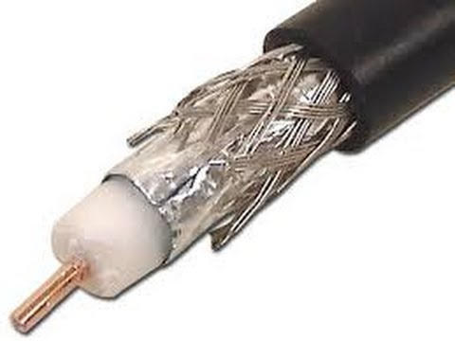
Ethernet Background
Goal
Common medium for devices to communicate with each other
Transmit any time, any length
Open standard
Flexible data format
Started as coax cable

Slide 6
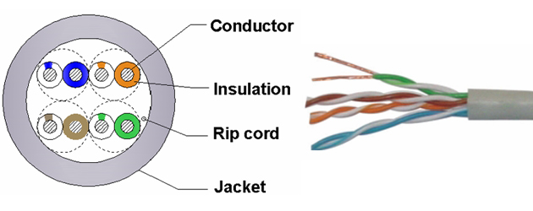
Ethernet Background
Cables –
Cables must support the speeds of the devices connected. Divided into Categories for easy reference. Unshielded twisted pairs.
Cat-3 – 16MHz Bandwidth
Cat-4 – 20MHz Bandwidth
Cat-5 – 100MHz
Cat-6 – 200MHz
Notes:
Noise profiles

Slide 7
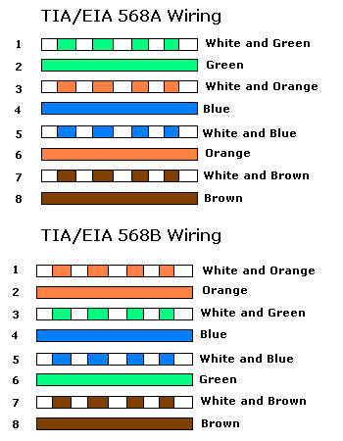
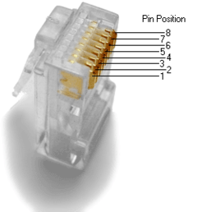
Ethernet Background
8P8C – (RJ45) Connector
Notes:
Two different color codes for cables

Slide 8
Ethernet Background
Unshielded Twisted Pair Specs
Resistance
Return Loss
Attenuation
Near-End Cross Talk (NEXT)

Slide 9
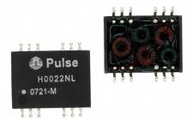
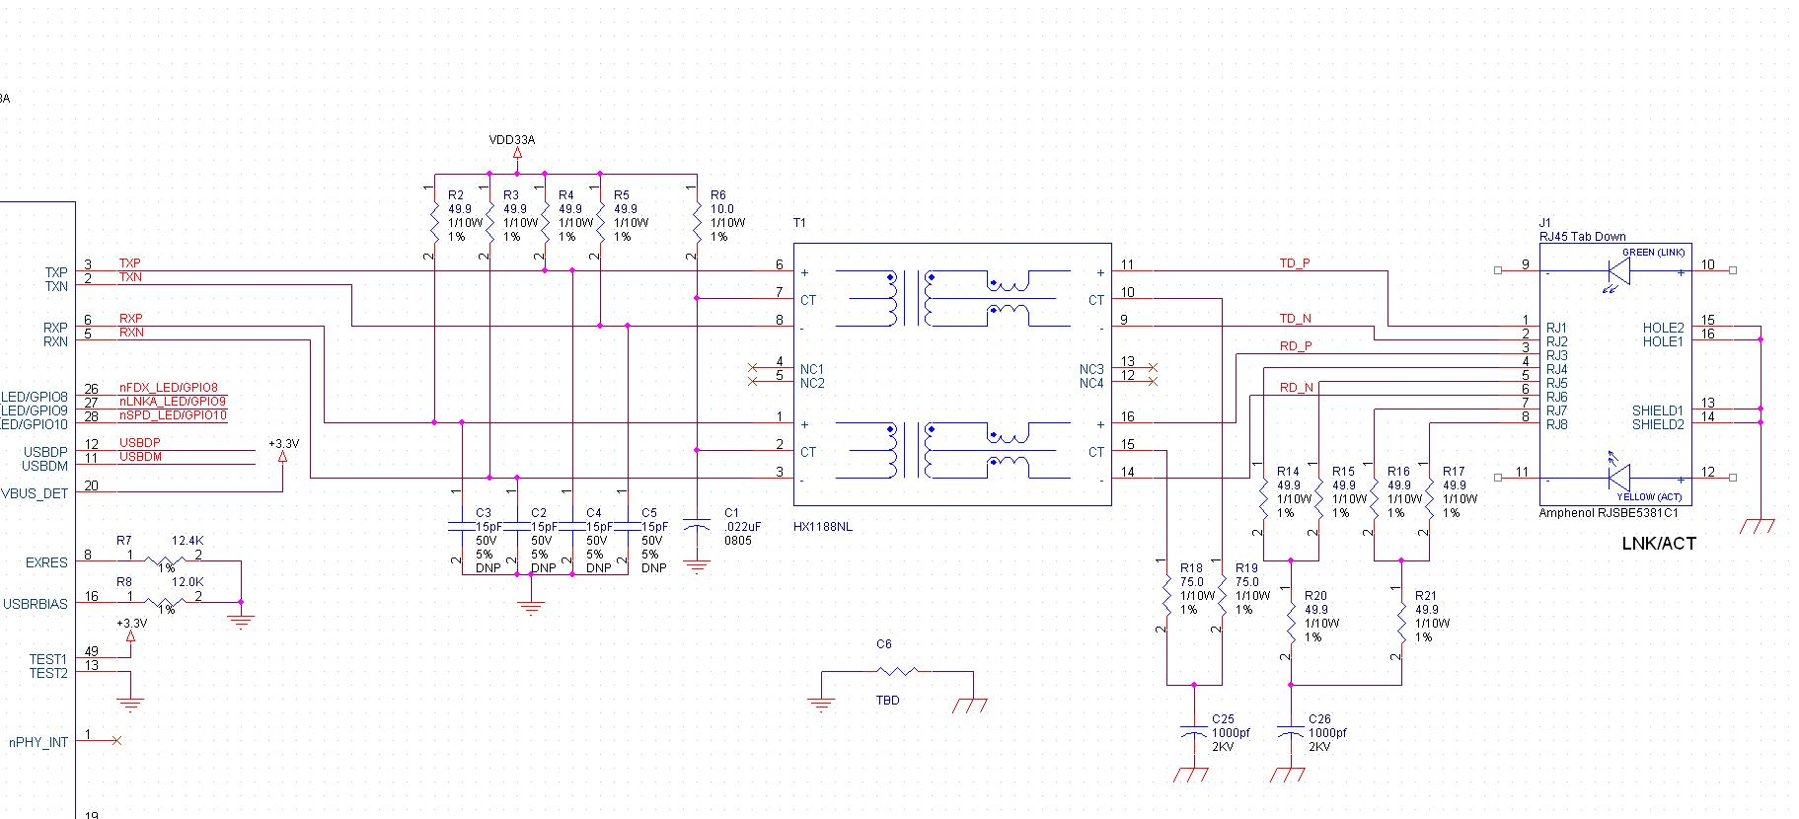
Ethernet Background
How do I get signals across 100m?
AC Signals

Slide 10
Ethernet Background
Communication Speeds
Ethernet
10Base-5, 10Base-2
Coax Ethernet Bus
10Base-T
Most common protocol
Fast Ethernet
100Base-T2, 100Base-T4
Old Cat-3 based Ethernet
100Base-TX
Most common protocol
Gigabit Ethernet
1000Base-T

Slide 11
Connectivity
From Coax to Twisted Pair
PHY

Slide 12
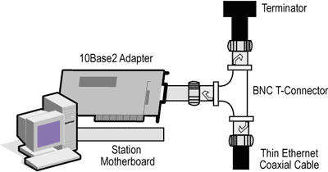
Connectivity
Coaxial cable – 10Base-2

Slide 13
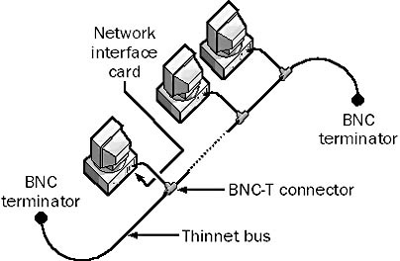
Connectivity
Half-Duplex
Original design
One Transmitter at a time
Bus topology

Slide 14


Connectivity
Collision Detection (CSMA/CD)
CSMA – Carrier Sense Multiple Access
CD – Collision Detect
Source of Minimum Frame Length Requirement
Hello!
Hello!
Hey There!
Hello!
HellHrgh!
Notes:
Group Conversations
Algorithm – Transmit when idle, Listen when others are transmitting, Collision occurs 4 byte Jam and wait a random amount of time.

Slide 15
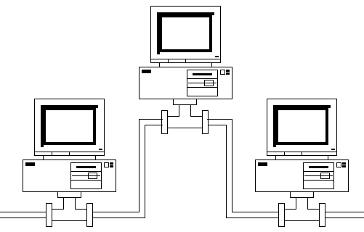
Connectivity
Bus Topology
Cheap
Sensitive

Slide 16
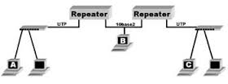
Connectivity
Bus Topology – Repeaters
Transition from one cable type to another
PHY level only (data is not changed or analyzed)
Physical Layer

Slide 17
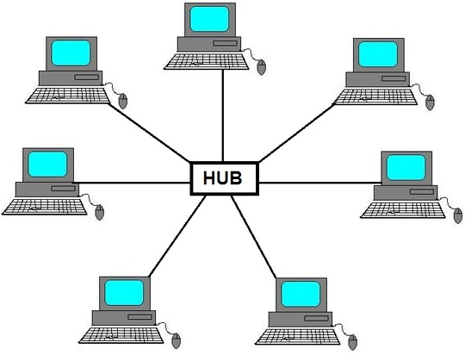
Connectivity
Star Topology - Hubs
Physical Layer
Notes:
Initial Star Topology with a Hub (Repeater Only) – Does not work with Full Duplex

Slide 18


Connectivity
Full Duplex
Two paths (TX/RX)
Talk and Listen at same time

Slide 19
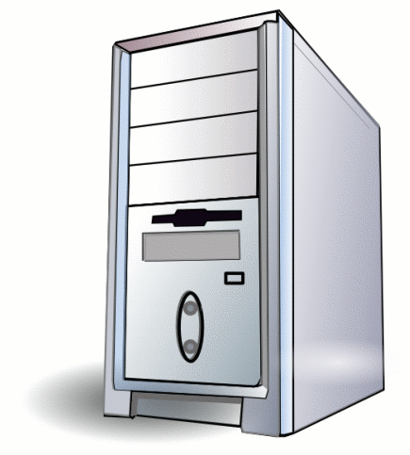
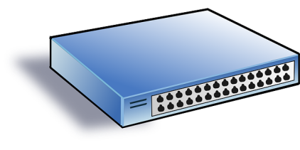
Connectivity
Switches
Data Link Layer
Physical Layer

Slide 20
Connectivity
Routers – Like Switch, just at IP layer
Network Layer
Data Link Layer
Physical Layer

Slide 21
Physical Layer
PHY Specifications

Slide 22
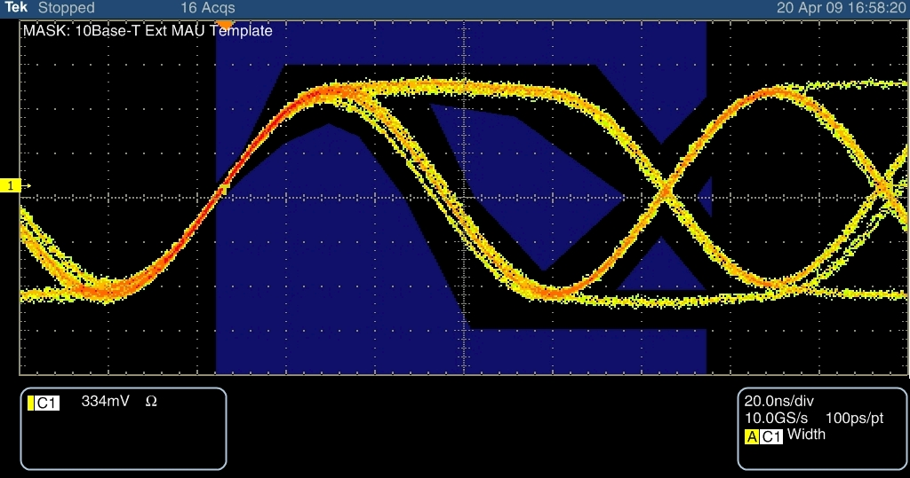
PHYs: 10Base-T
Signaling
10Mbps
Two data pairs
Full Duplex support
1,2 & 3,6
Symmetry
+/- 1V MAX
AC, not DC
Rise Time
Fall Time

Slide 23
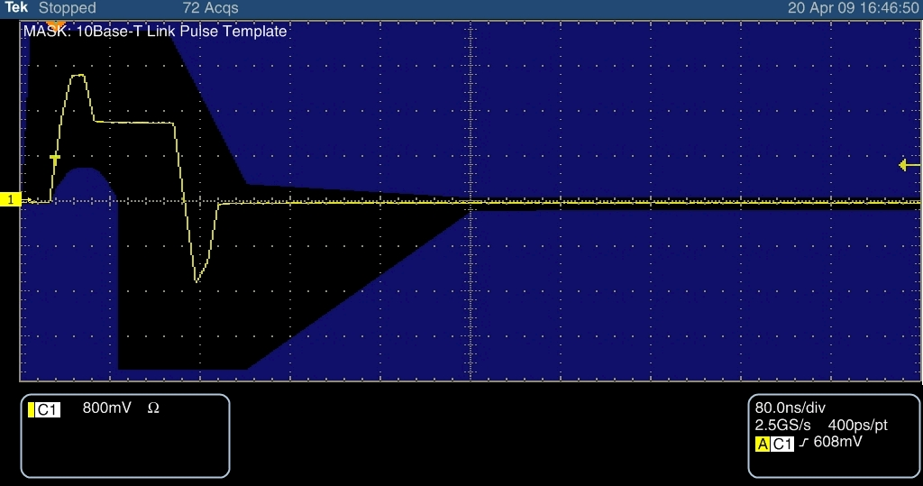
PHYs: 10Base-T
Idle State
Link Test Pulses (LTP)
Normal Link Pulse (NLP)
~100ns pulses every 8-24ms

Slide 24
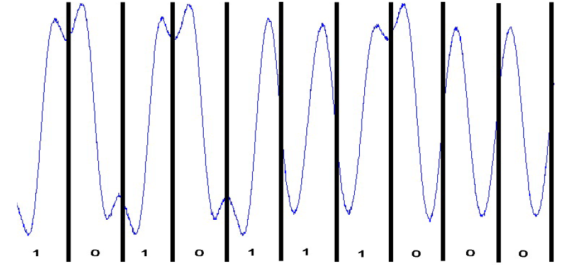
PHYs: 10Base-T
Encoding
Manchester Encoding – Always Changing

Slide 25
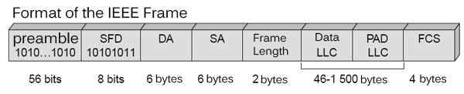
PHYs: 10Base-T
Packet format
Start Frame Delimiter (SFD)
Clock Recovery
Notes:
Address Link check if the RX clock is out of phase with the TX clock

Slide 26
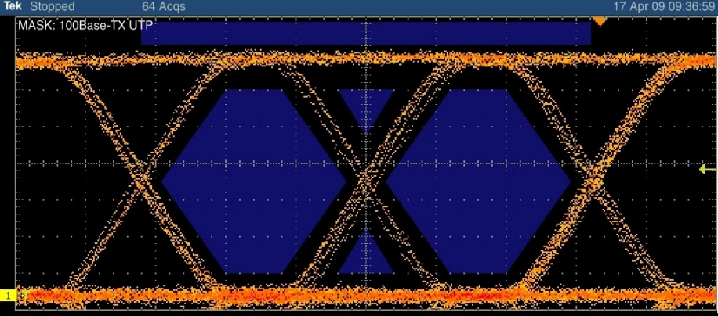
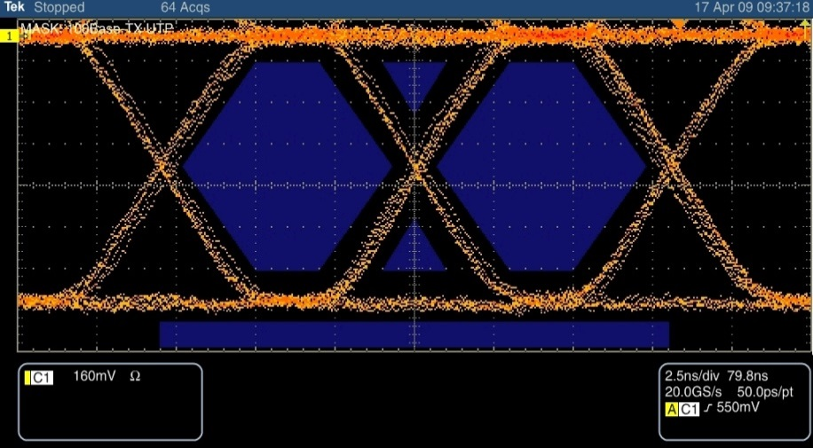
PHYs: 100Base-TX
Signal
100Mbps
Two data pairs
1,2 & 3,6
Full Duplex support
MLT3 Signals

Slide 27
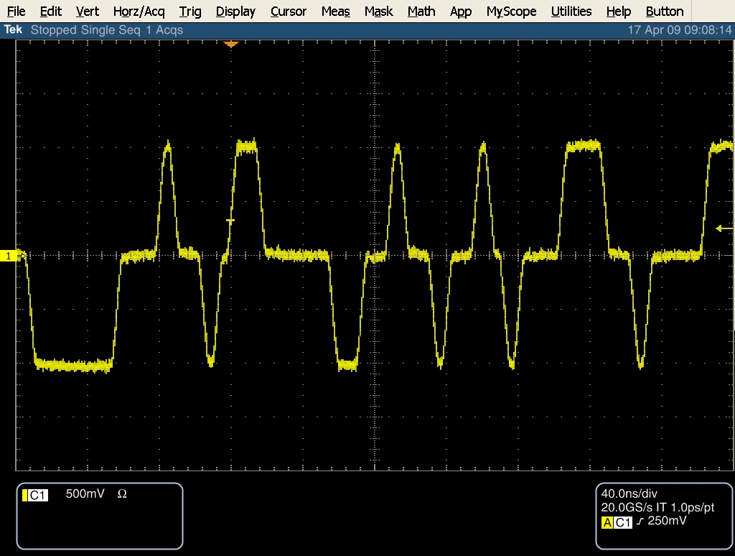
PHYs: 100Base-TX
Idle State
MLT3 Scrambled
31.25MHz avg
Notes:
Scrambled 33MHz signal

Slide 28
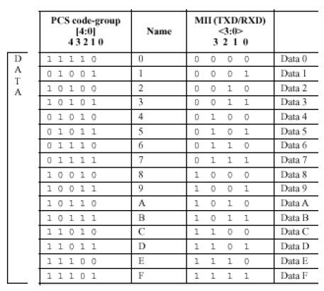
PHYs: 100Base-TX
Encoding
4B/5B
Always changing
Control Signals
11111 – Idle
J – 11000
K – 10001
T – 01101
R – 00111
Start of frame (JK)
End of Stream (TR)

Slide 29
PHYs: 100Base-FX
Same as 100Base-TX
5B/4B Encoding
Same interface to MAC
Optical media means longer distance
2000m for Full Duplex
412m for Half Duplex (Collision detection)
Some things not needed
No scrambler for noise
No MLT3 for cable bandwidth

Slide 30

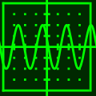
PHYs: 1000Base-T
Gig Ethernet
Very Complicated
125MHz Symbol Rate
Transmit AND Receive on all 4 lines
PAM5
Complicated DSP to cancel out Transmitted signals

Slide 31
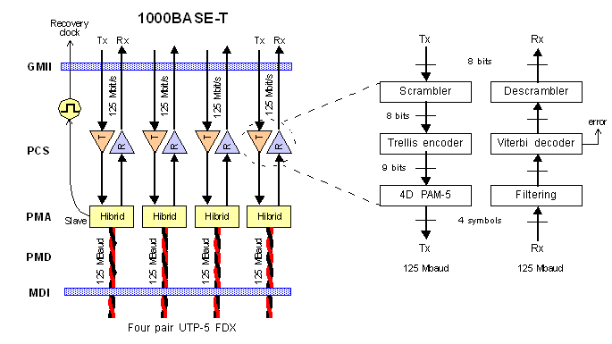
PHYs: GigE Architecture
The physical layer is split into the Physical Coding Sublayer (PCS) and the Physical Medium Attachment (PMA) sublayer.
The PCS controls logic functions.
The PMA performs analog-digital mixed signal functions.

Slide 32
PHYs: 1000BASE-T PCS
The four data lines (4 UTP wires) are used simultaneously to transmit/receive.
Each byte is mapped into 4 pulse amplitude modulation (PAM) symbols.
Five symbols form the PAM constellation being used {+2, +1, 0, -1, -2}.
Data encoding needs only four levels (two bits per symbol), the fifth is used as forward error correction (FEC) coding.
In the absence of data, IDLE symbols (restricted to {+2, 0, -2}) are used to keep synchronization.
Each wire pair achieves 250Mbps throughput using baseband signaling at 125MBaud (1 Baud = 1 symbol/s) on each of the pairs.
Achieving 1Gbps at a spectral power density similar to that of 100BASE-TX.
There are 625 possible symbols (5⁴), leaving 512 patterns for data and 113 for control codes such as idle, start of packet and end of packet.

Slide 33
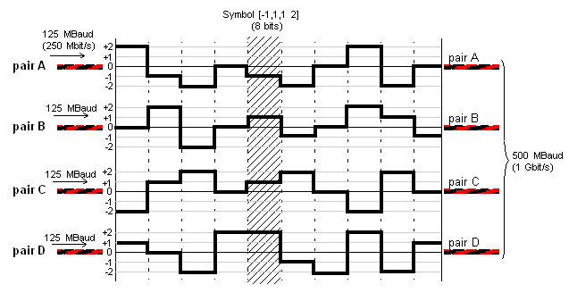
PHYs: 1000BASE-T PCS
PAM5 signaling

Slide 34
PHYs: 1000BASE-T Encoding
First, eight bits of data are expanded into four 3-bit symbols through a non-trivial scrambling procedure based on a linear feedback shift register; this is similar to what is done in 100BASE-T2, but uses different parameters.
A 4-Dimensional 8-state Trellis Coded Modulation technique is used to encode the four 3-bit symbols to a 9-bit representation, which can then be converted to the PAM5 symbol via a lookup table.
A few example encodings are shown below:
Encode Symbol PAM5 Symbol
010011001 [-1, +1, 0, -2]
110010011 [-1, -2, +1, 0]
100101001 [-1, 0, +2, +1]

Slide 35
PHYs: 1000BASE-T Decoding
On the receiver side, the 4D/PAM5 symbols are decoded using a Viterbi Decoder which provides error correction, not just error detection (as in 100BASE-TX).
The resulting data is then descrambled, using another LFSR.

Slide 36
PHYs: 1000BASE-T PMA
The PMA is made up of four independent receivers and transmitters to provide full duplex communication over the four pairs of UTP cabling.
Hybrid circuits are used to enable bidirectional communication over the same pair.
They perform sophisticated DSP, filtering and equalization of the received signal.
They also perform echo cancelling and remove crosstalk, to compensate for distortion from the UTP wiring.

Slide 37
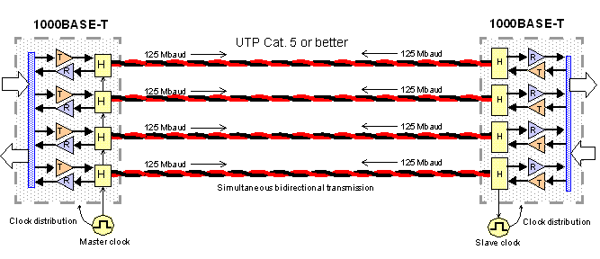
PHYs: GigE Full Duplex Transmission
1000BASE-T transmits and receives signals simultaneously over the same pairs. Synchronization is important to be able to decode and implement data filters. Each link pair must have a master and slave and keep transmitting a continuous stream of IDLE symbols during gaps in data.

Slide 38
PHYs: Negotiation
What happens when RX/TX are swapped?
PHY
TX
RX
Notes:
Autoneg random seed is based on the power supply of the chip and the PHY address.
Systems that share the same supply and PHY address will have the same autoneg switching!

Slide 39
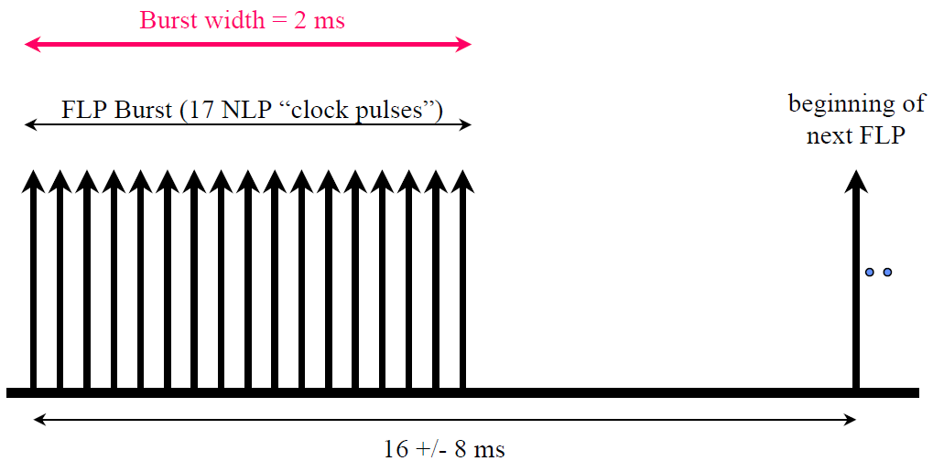
PHYs: Negotiation
FLP

Slide 40
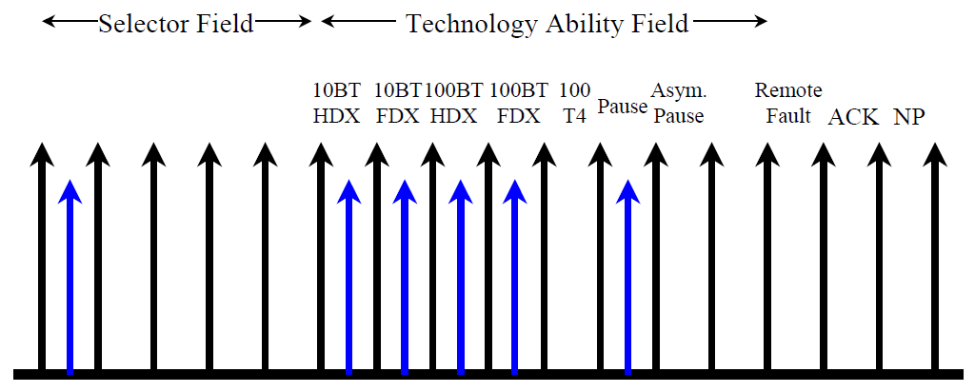
PHYs: Negotiation
FLP

Slide 41
PCB design guidelines

Slide 42
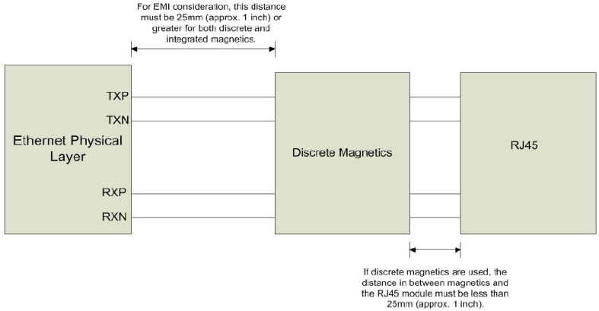
Discrete Magnetic and RJ45 Placement
>=25mm, help to EMI
<=25mm

Slide 43
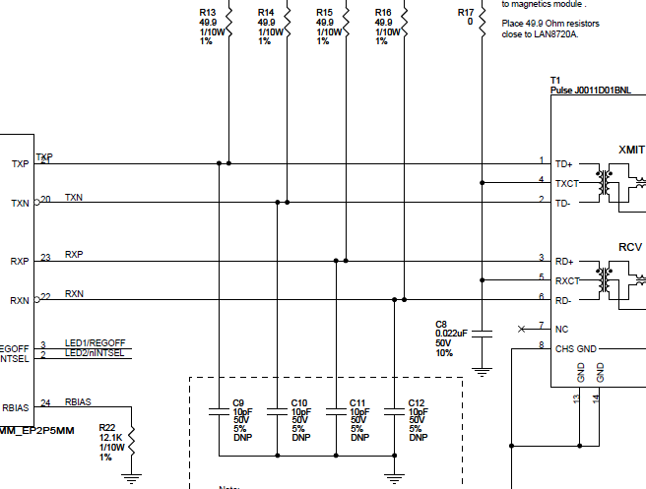
Termination Resistors and EMI Caps Placement
49.9 ohm close to PHY
PHY
Magnetic
10pF close to Magnetic
Notes:
The caps should be placed as to create the smallest possible stub

Slide 44
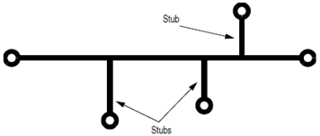
Differential Pairs
TXP/TXN, RXP/RXN are differential pairs and need to be designed to a 100 ohm differential impedance.
TXP and TXN must be equal length and symmetric with regards to shape, length, and via count, RXP and RXN as well.
Isolate TX/RX traces from nearby circuit and signals, with distance greater than or equal to 5 times of spacing between the traces.
Better not to use via
Avoid using 90 degree turns
Avoid Stubs
TX pair
S
>=5S
RX pair
>=5S
Clock

Slide 45
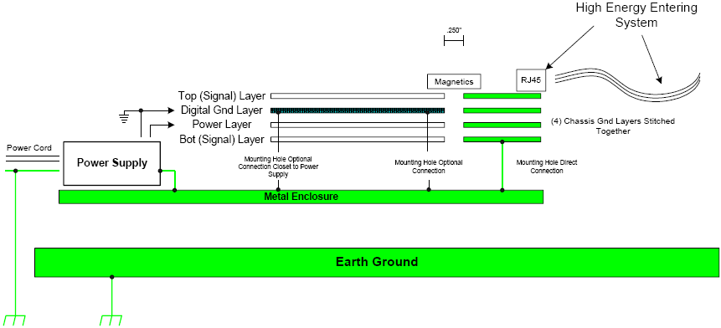
Ethernet Chassis Ground System for ESD
High energy entering system:
Lightning or surge through Ethernet cable
CDE when connect Ethernet cable
Direct touch to RJ45 metal case
Spark gap touch to RJ45 metal case
High energy pass channel:
Ethernet cable (used / unused pins) → 75 Ohm resistor → 2kV cap → Metal Enclosure
Direct/spark gap touch to RJ45 metal case → Metal Enclosure
X

Slide 46
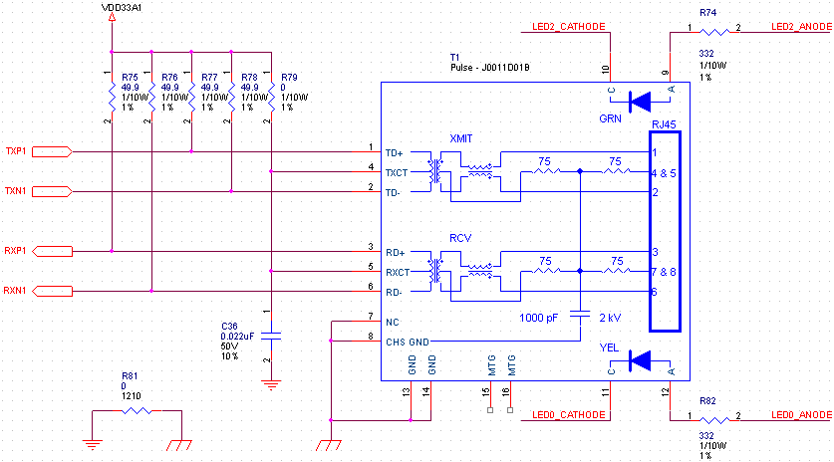
Solutions to ESD / Surge
Isolate Chassis ground and signal ground can help to prevent Common Mode ESD/Surge entering signal ground.
TVS / serial resistors / FBs / inductors on TXP/N and RXP/N can help to prevent differential mode ESD/Surge entering IC pins.
Differential Mode
High energy
Single point Connection
For Chassis ground and signal ground
Common
Mode

Slide 47
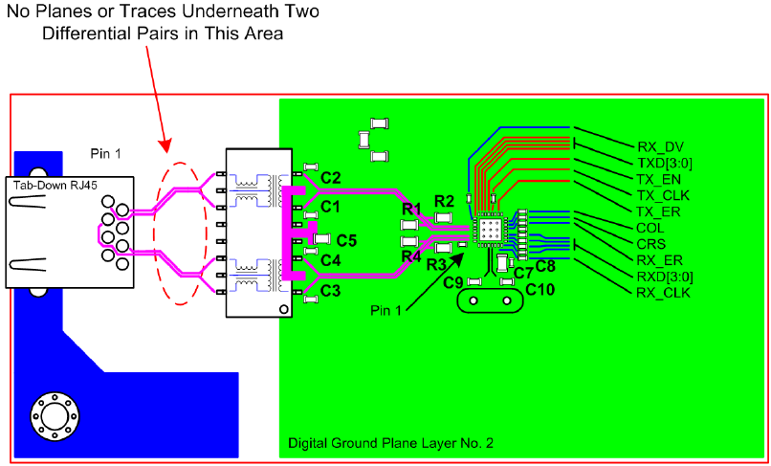
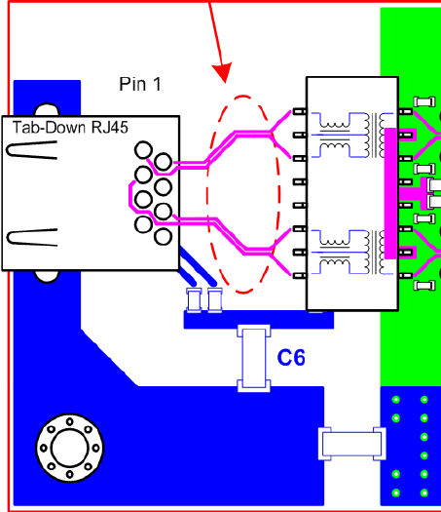
RJ45 and Magnetics Ground Design

Slide 48
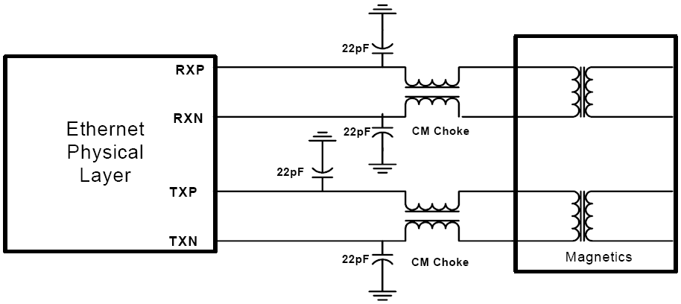
EMI Consideration
The capacitors is helpful to 500MHz-1GHz emission
The CM choke is helpful to >100MHz
Terminate resistors on MII interface
RMII 50MHz ref clock should be with ground surrounded
Check the power supply ripple
Try FB / resistor / inductor to connect chassis ground and signal ground

Slide 49
Performance test

Slide 50
Performance test Equipment / Utility
Ethernet Conformance Test – 802.3: related to PHY
Tektronix TDSET3
Agilent N5392A
LeCroy QPHY-ENET
Throughput Test: related to MAC
Commercial
Smart-bit RFC2544 test suite
IXIA-Chariot
Fluke
Novel Performance3
Open Source
NETPERF
IPERF
NDS
NetIO

Slide 51

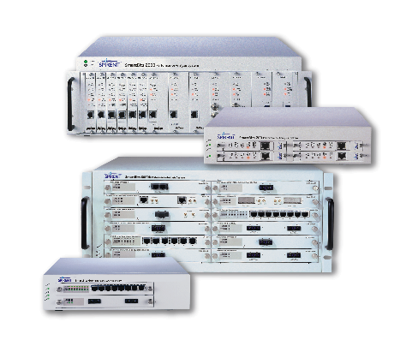
Performance Test: SMARTBIT RFC 2544
Use SMARTBIT RFC 2544 to test performance of Ethernet
Device need respond to Ping packet from SMARBIT
A control script (either in TCL or compiled format) can control the test parameter
Using “binary search algorithm” to get the performance result

Slide 52
Introduction to RFC 2544
RFC 2544 defined Benchmarking Methodology for Network Interconnect Devices
Benchmarking item:
Throughput
Latency
Frame loss rate
Back to back frame
System recovery
Reset
At different media-type, duplex, frame size(64,128…1024) within specific duration (minimum 60 sec.)
Functional test:
Error packet handling (CRC, Alignment, Dribble, Symbol)
ARP

Slide 53
Test tool: NETPERF
Open source code from HP (free of charge)
Release in C source code. It can be easily ported to different CPU/OS tool chain for embedded system
All tests are under “TCP/IP” ready environment
PC side (DOS) compiled code can get from SMSC
User need simply compile the client side source code and install it and run the script

Slide 54
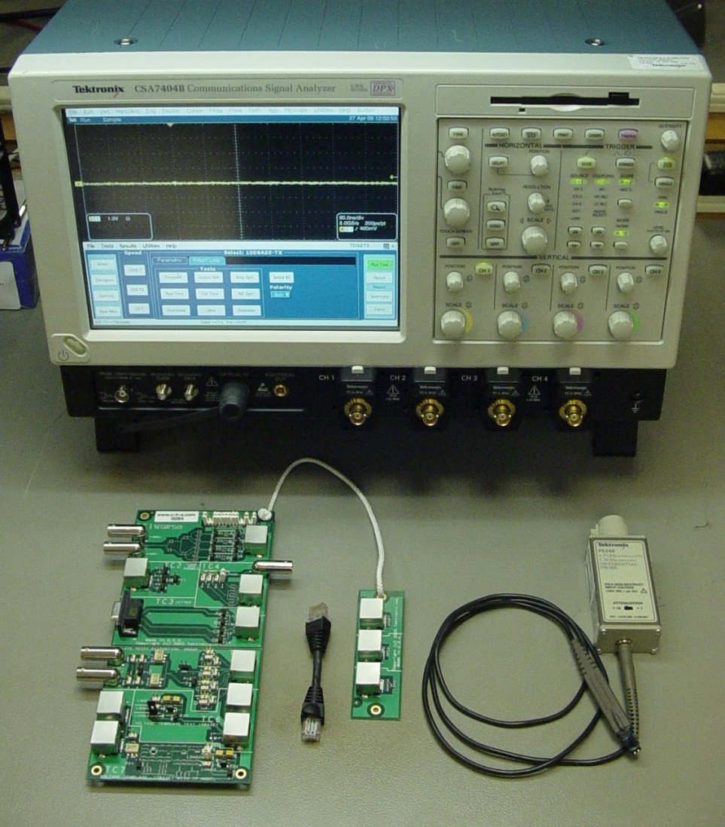
IEEE 802.3 Compliance Test - Tektronix TDSET3
TDSET3 User Manual available at www.tekronix.com
10Mb, 100Mb, 1Gb
Transmitter Electricals Only
Equipment Used
Tektronix Oscilloscope
TDS/CSA7000
DPO7000
Differential Probes (qty 2)
P6247 – 1GHz
P6248 – 1.5GHz
Arbitrary Waveform Generator
AWG610
AWG2021
Crescent Heart Probe Fixture

Slide 55
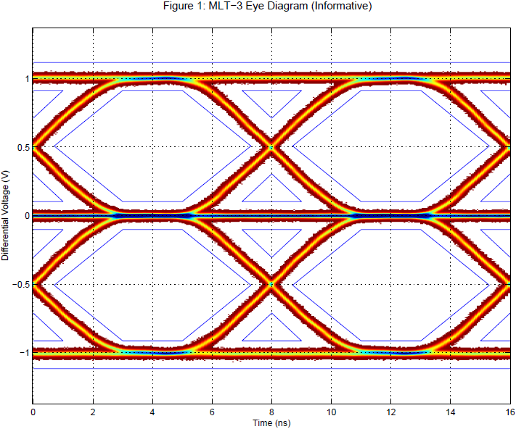
100M test items in TDSET3
AOI Template
Output Voltage (+Vout)
Output Voltage (-Vout)
Amplitude Symmetry
Rise Time(+ve)
Rise Time(-ve)
Fall Time(+ve)
Fall Time(-ve)
Rise/Fall Symmetry(+ve)
Rise/Fall Symmetry(-ve)
Overshoot(+ve)
Overshoot(-ve)
Transmit Jitter(+ve)
Transmit Jitter(-ve)
Distortion (Duty Cycle)

Slide 56
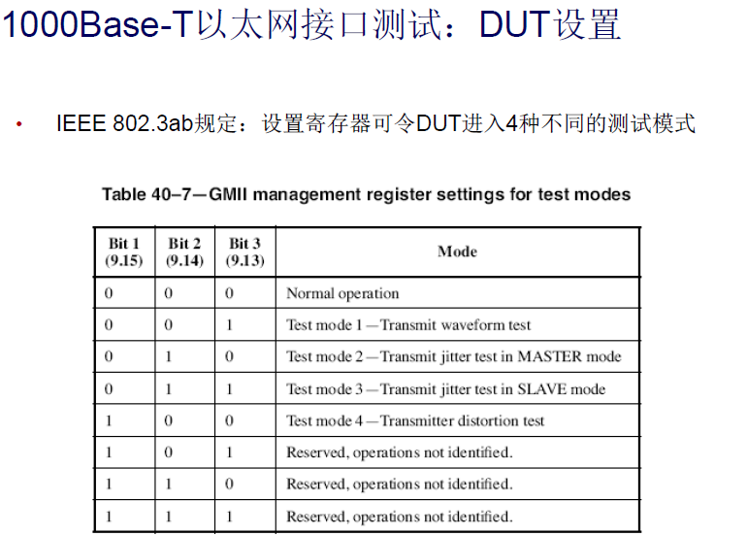
1000M DUT Setting

Slide 57
THANK YOU
QUESTIONS?

